Slide 1

Pros and Cons Analysis: Chatbot Building Tools

Slide 2
Building from scratch Vs. Chatbot APIs
Building from scratch Vs. Chatbot APIs
Approach | Pros | Cons
Building/Coding from scratch | Allows customization | Requires skilled developers
 | Allows scalability in long run | Developer must design all the features including platform integration
 | Gives more control over the bot | Time consuming
 |  | Expensive
Chatbot API | Does not need a developer to build (Zero coding involved) | Limitations in scaling the bot in future
 | No hurdles of hosting environments and server configuration | No full control over conversation flows
 | Less expensive (compared to hiring a developer) | Limited functionality
 | Easy to use interface (drag and drop interface)

Slide 3
Building from scratch Vs. Chatbot APIs
Building from scratch Vs. Chatbot APIs (Contd.)
Approach | Pros | Cons
Chatbot API | Easy integration with third party applications
 | Quicker to build

Slide 4
Building from scratch Vs. Chatbot APIs
Comparison among Chatbot APIs
 | Coding Requirement | Support Documents | Inbuilt Analytics | Live Chat Integration | Pricing Model
Facebook messenger API and chat plugin | Yes | Yes | Yes | Yes | Free
Artibot.ai | No | Yes | With Google Analytics | Yes | Free
Microsoft QnA | No | Yes | Yes | Yes | Standard Plan
Google Dialogflow/ api.ai | No | Yes | Yes | Yes | Initial credit of $600 + Pay as you go
IBM Watson Conversation | No | Yes | Yes | Yes | Free with Limited Features/ Pay as you go
Botsify | No | Yes | Yes | Yes | Standard Plan
Notes:
Facebook Messenger API and Chat Plugin : Detailed documentations along with code snippets for copy paste use are available in Facebook Messenger API
Artibot. ai : Paid plan is also available with unlimited features. But the free plan included extended features too and suits the current use case

Slide 5
Building from scratch Vs. Chatbot APIs
Comparison among Chatbot APIs
Common features in these APIs which support our requirement :
Allows live chat integration
Allows chat buttons
No or minimal coding
Provides NLP/NLU services
Can be launched on company website
Easy integration (One click integration)
Allows inbuilt analytics options except in artibot.ai
Detailed support documents that guides one through the whole process including integration

Slide 6
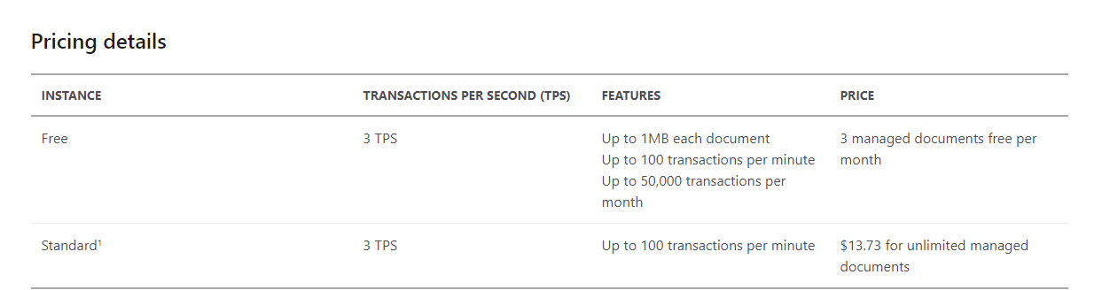
Building from scratch Vs. Chatbot APIs
Pricing Model
Microsoft QnA

Slide 7
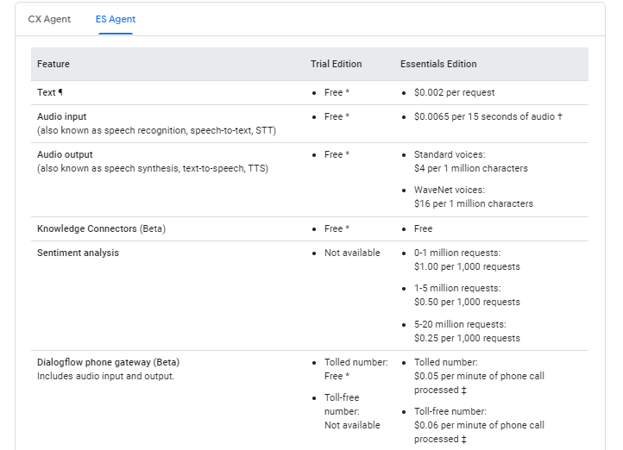
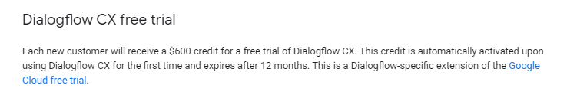
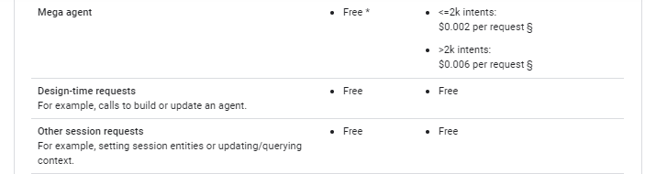
Building from scratch Vs. Chatbot APIs
Pricing Model
Google Dialogflow / api.ai

Slide 8
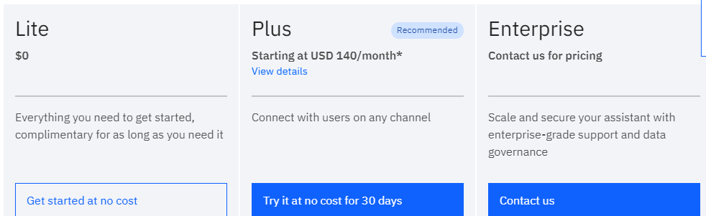
Building from scratch Vs. Chatbot APIs
Pricing Model
IBM Watson

Slide 9
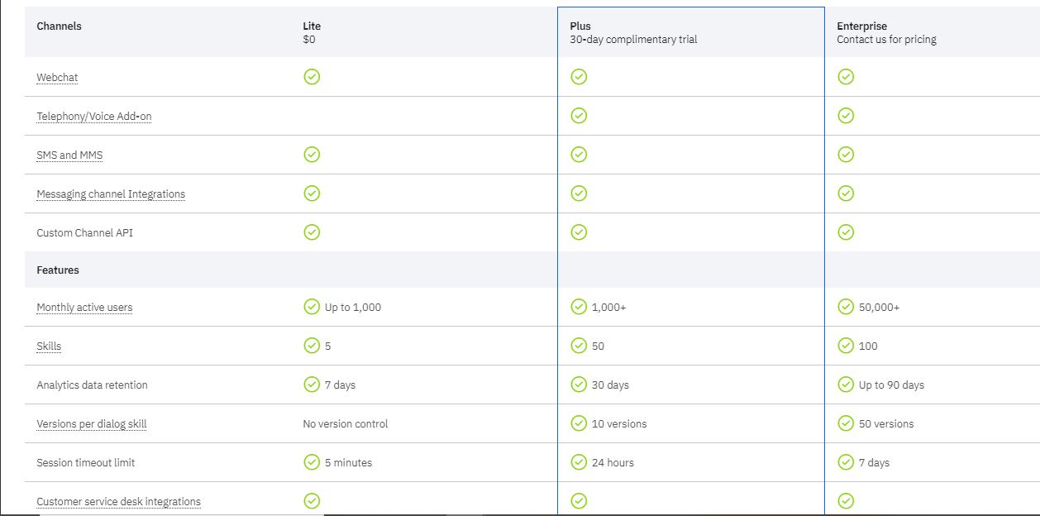
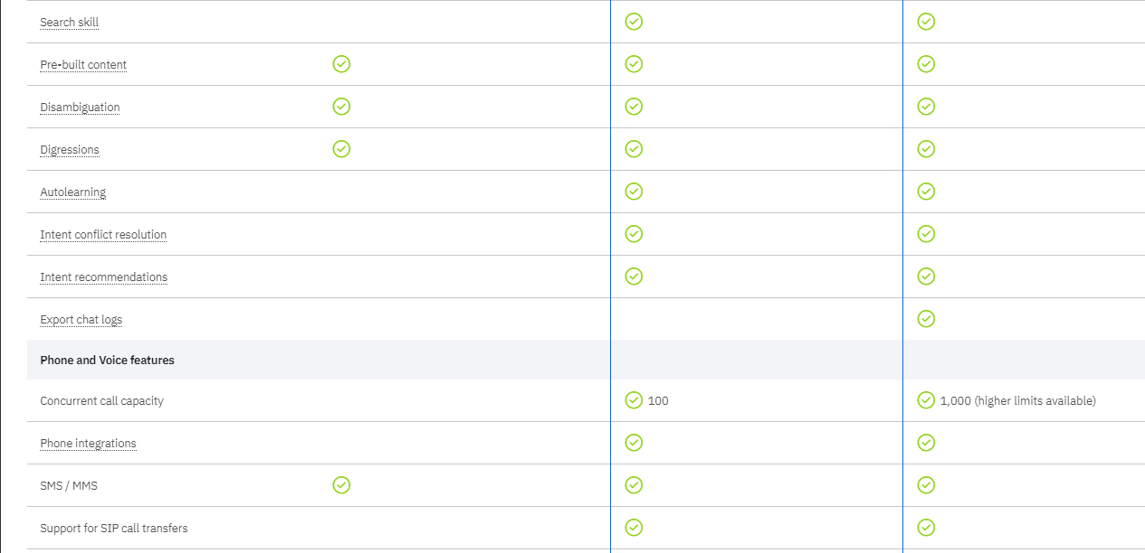
Building from scratch Vs. Chatbot APIs
Pricing Model
IBM Watson

Slide 10
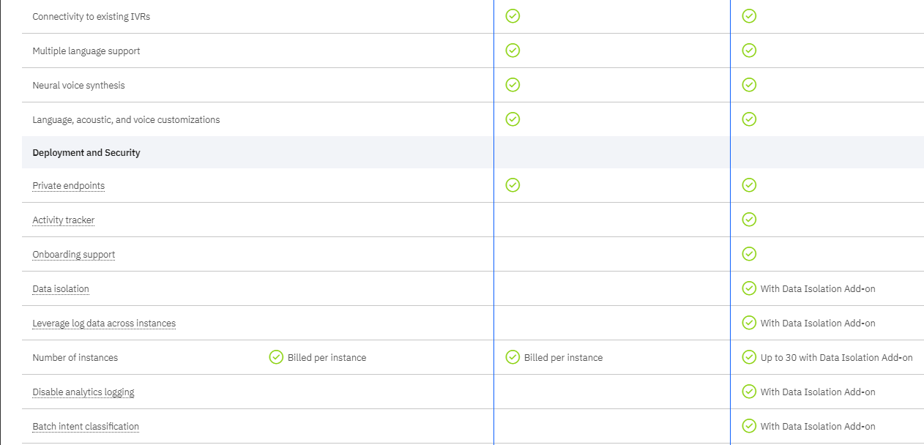
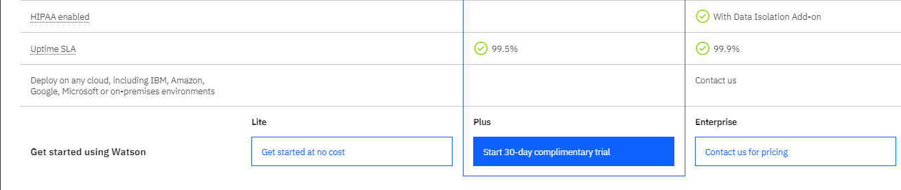
Building from scratch Vs. Chatbot APIs
Pricing Model
IBM Watson

Slide 11
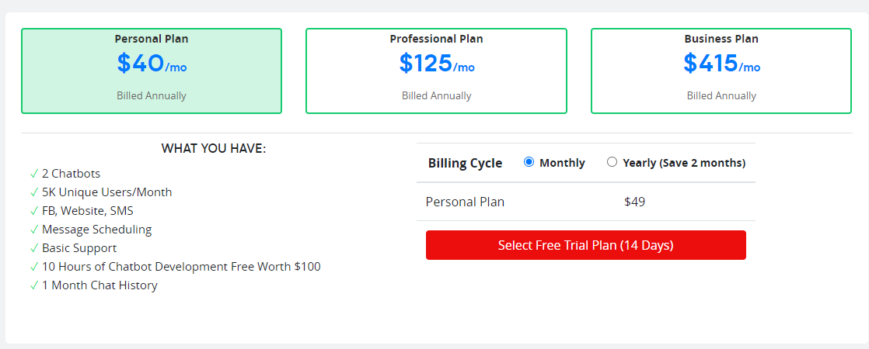
Building from scratch Vs. Chatbot APIs
Pricing Model
Botsify

Slide 12
Building from scratch Vs. Chatbot APIs
Other Popular Chatbot Building Platforms
Microsoft LUIS
Amazon Lex
ChatBot API
Chatfuel
Octane AI
Snatchbot
Bold360
Botengine
Notes:
They have similar features to the 5 APIs mentioned before. None of them provide a free service and is charged on different plans ranging between $30 to $80 monthly

Slide 13
Building from scratch Vs. Chatbot APIs
Summary
I worked on a demo bot with these 5 APIs : Facebook messenger API, Artibot.ai, Microsoft QnA, Google Dialogflow/ api.ai, IBM Watson Conversation, Botsify and some of the highlights are -
Microsoft QnA is the easiest to use and quickest bot builder to work with. It also supports training dataset in different extensions, but comes at a standard pricing plan.
Google Dialogflow is more popular among the others due to it’s flexibility in building conversation flows as per use case. It comes with an analytics dashboard which provides the scope of doing various analysis on chat history. It provides a $600 initial credit followed by Pay as you go plan. “ES Agent” would suffice the requirement of Digicor.
Facebook messenger API allows customization and integration in multiple platforms including website integration. It provides many resourceful features including buttons and lists for users to choose from. The documentations are elaborate and includes snippets of codes which are to be used at different junctures for building the bot. This platform too allows analytics to be performed on the chat data. This application is also available free of cost for use.
Considering the fact that most of these APIs provides similar features and has more or less the same ease of use and flexibility, Facebook Messenger API could be the best platform to use as this is available free of cost.

